Slide 1
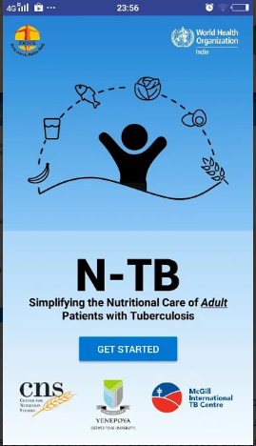
N-TB:
A mobile based application for nutritional assessment, counselling and nutritional care of adult patients with tuberculosis.
Developed by: Center for Nutrition Studies, Yenepoya(Deemed to be University), Mangalore.
In technical collaboration with:
Revised National TB Control Programme
World Health Organisation (India)
McGill International TB Centre

Slide 2
RNTCP Guidance document 2017
Nutritional assessment, counselling, support in Indian context.
Recommends hospitalisation of patients based on severity of undernutrition, vital signs and performance status.
Contains a separate chapter on management of severely undernourished in hospital setting.

Slide 3
N-TB app
Mobile based application freely downloadable from Google Play and Apple store.
Simplifies assessment, counselling and support for undernourished adult patients with tuberculosis
Weight and height are being recorded in TB treatment cards.
Helps in simplifying the calculation of BMI (weight in kg/(height in metres)² and guides further actions based on nutritional status.

Slide 4
N-TB app helps in:
Assessment and classification of nutritional status based on BMI
Action based on the nutritional status
Indicates desirable weight and required weight gain depending on the current weight
It indicates recommended daily calorie and protein intake.
It provides tailored tips for dietary counselling for TB patients
Simple information on all food groups, their caloric and protein content
There is focus on locally available and cost-effective foods.

Slide 5
On the home screen
Press “Get started”

Slide 6
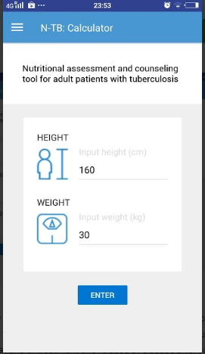
Calculator screen appears
Enter height in cm and weight in kg
For example in a patient:
Height is 160 cm
Weight is 30 kg,
Press “Enter”

Slide 7
N-TB app classifies the BMI in colour coded manner
In this example:
It is extreme underweight category
The app gives the BMI value which is very low
Press “Next”

Slide 8
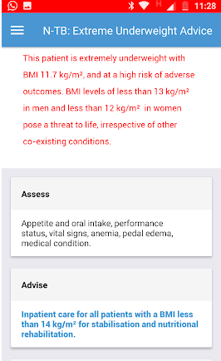
Action
The next page indicates that the patient is extremely underweight
Fulfils indications for admission
The page also gives a summary of in-hospital management of severe undernutrition.
Press “Next”

Slide 9
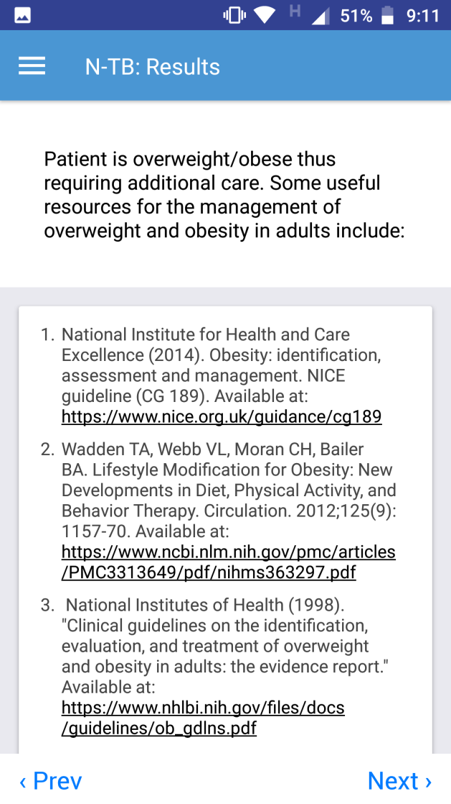
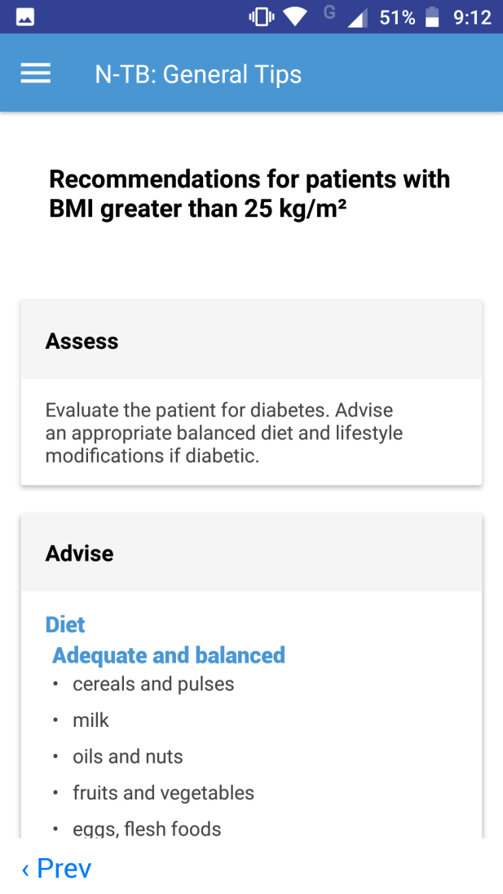
The app gives tailored messages depending upon BMI
BMI in normal range
BMI in overweight range. App also suggests evaluation for diabetes

Slide 10
Next screen gives current and Target weights and weight gain required
Desirable weight = Weight required for BMI of 21 kg/m²
Minimum acceptable weight = Weight required for a BMI of 18.5 kg/m²
Desirable weight gain = Desirable weight – current weight
Minimum weight gain recommended = Minimum acceptable weight – current weight
Scroll down screen for recommended daily caloric and protein intake

Slide 11
Recommended daily caloric and protein intake
Recommended daily calorie intake for underweight.
(based on 40 kcal/kg of desirable weight)
Recommended daily protein intake for underweight.
(based on 1.2 -1.5 g/kg of desirable weight)
Press “Next”

Slide 12
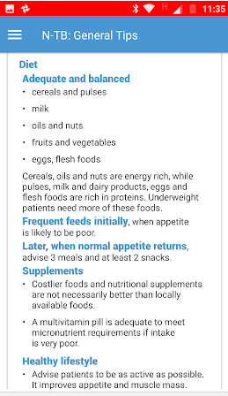
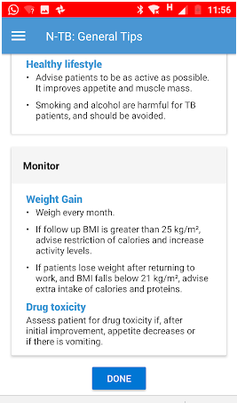
Counselling tips
On adequate balanced diet
Number of meals and snacks
Clarifying misconceptions about costly supplements and costly foods
Advice on lifestyle.
Advice on Monitoring
Enter “Done”

Slide 13
On pressing Done, the N-TB calculator screen re-appears
Press on the Divisions to see a menu
Gives information on:
Food groups
Classification of nutritional status according to BMI

Slide 14
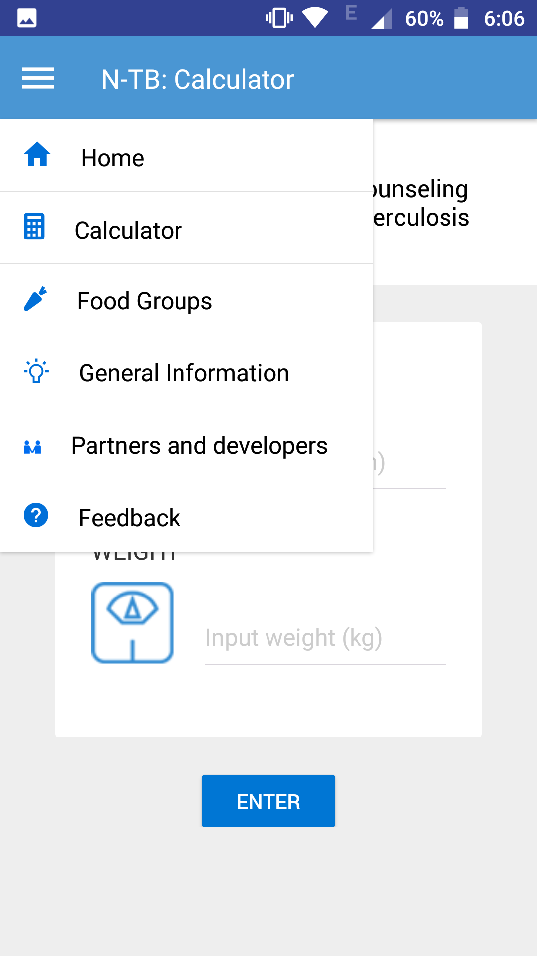
Menu
The menu mentions:
Home
Calculator
Food groups: cereals, pulses, milk and dairy, non-vegetarian foods
General information on classification of nutritional status

Slide 15
For meal plans, model diets, exchange lists of foods
Please see pages 88-92 of the RNTCP Guidance document on Nutritional care and support of patients with tuberculosis in India.
Links to the RNTCP document are provided in the counselling tips page, general information page of the app.

Slide 16
Thank you

